Slide 1
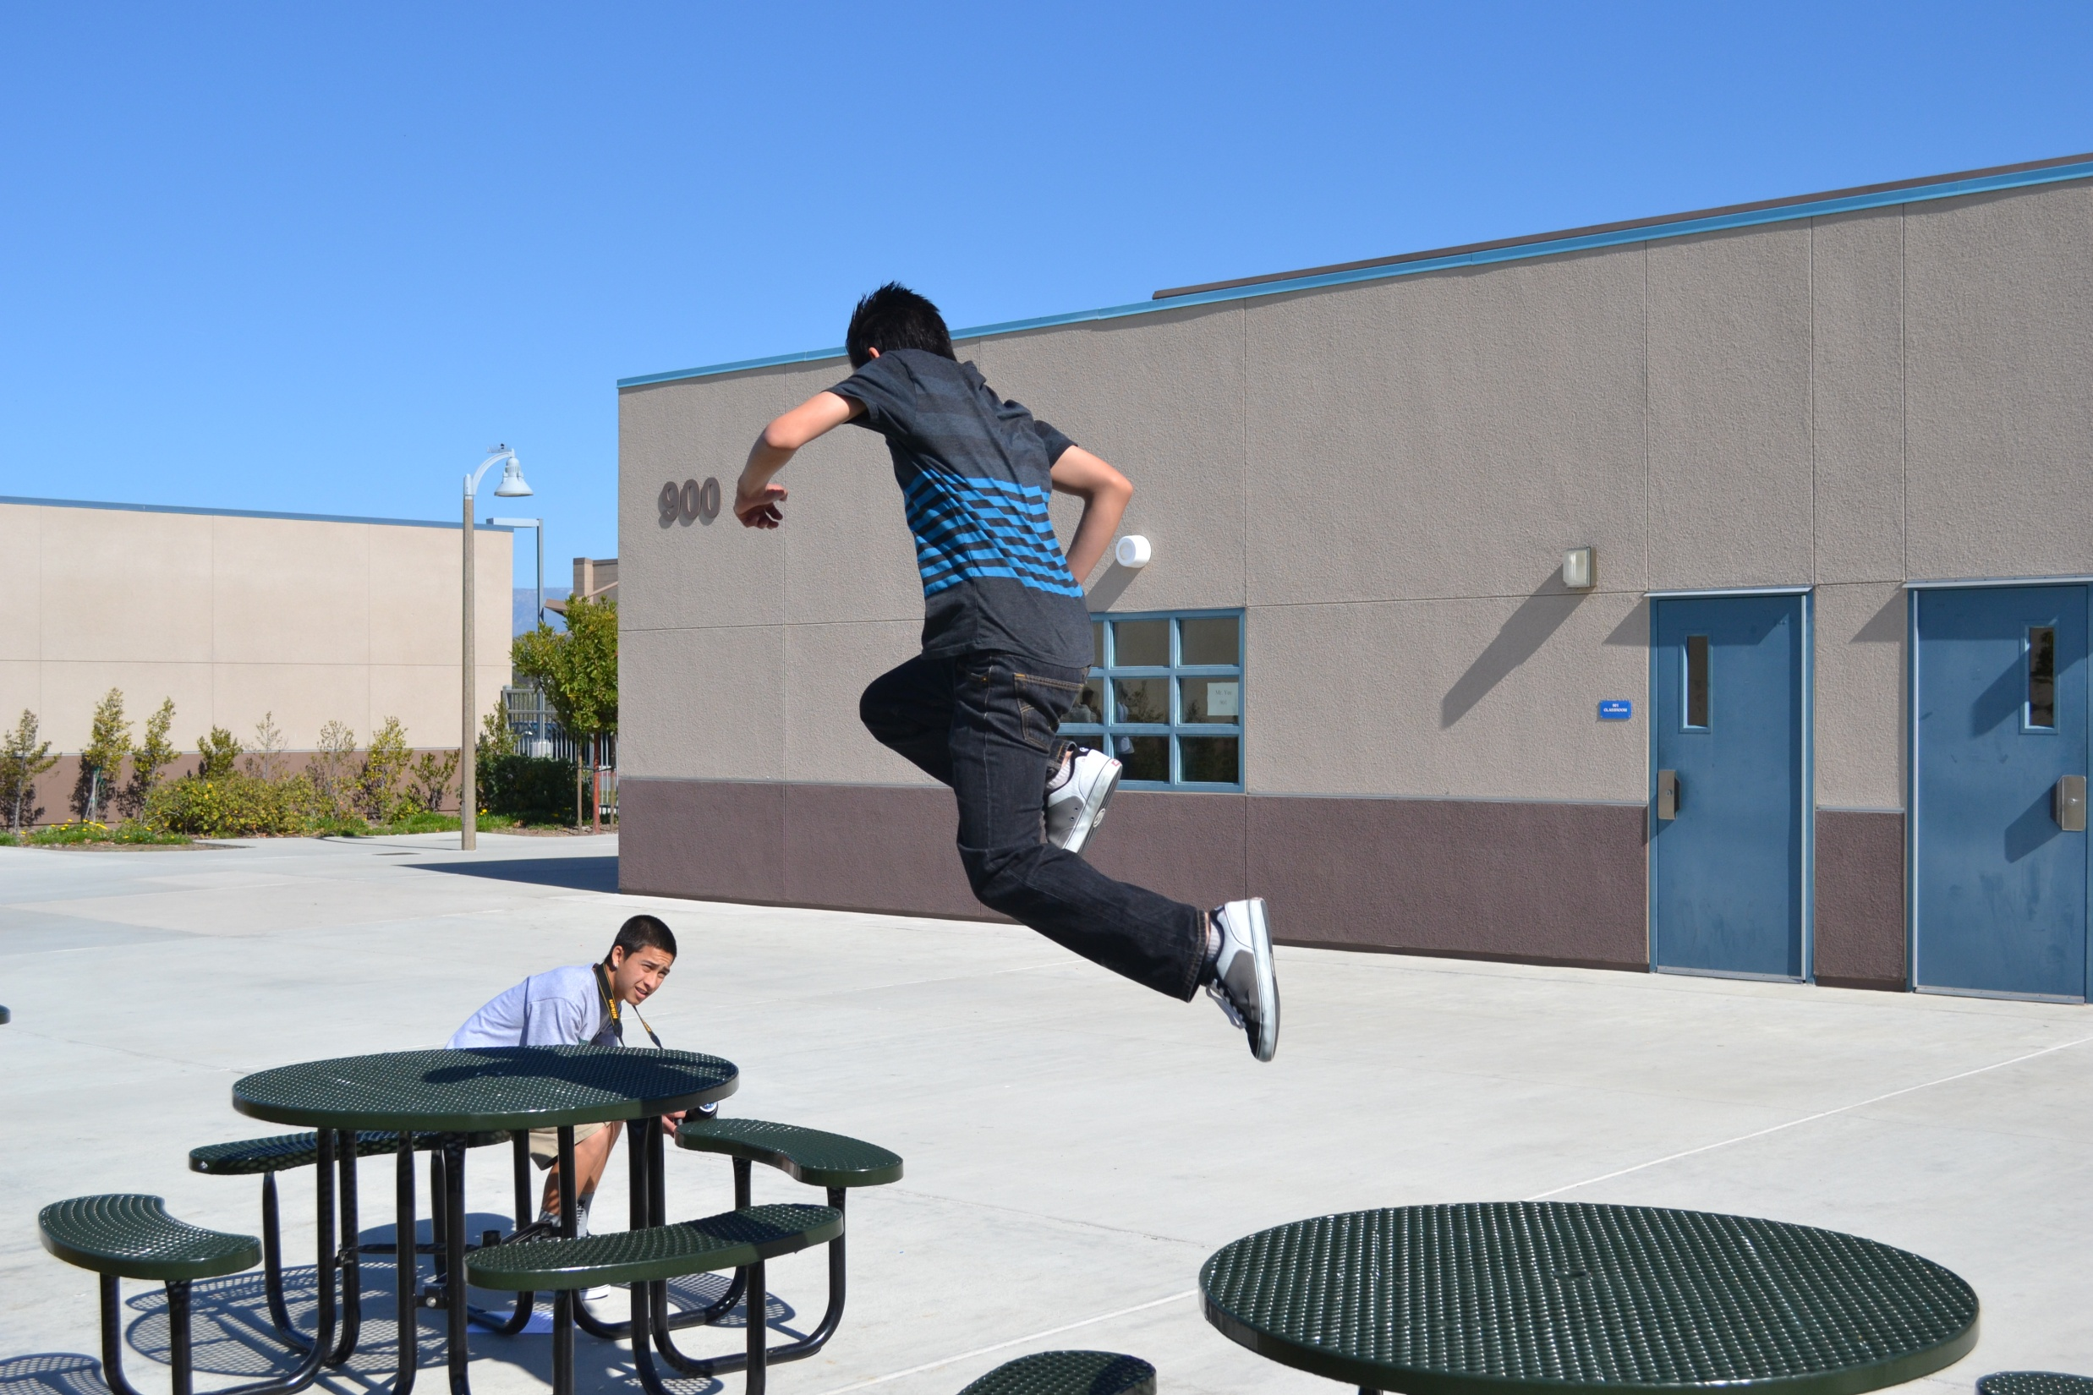
Regan Cunneen

Slide 2
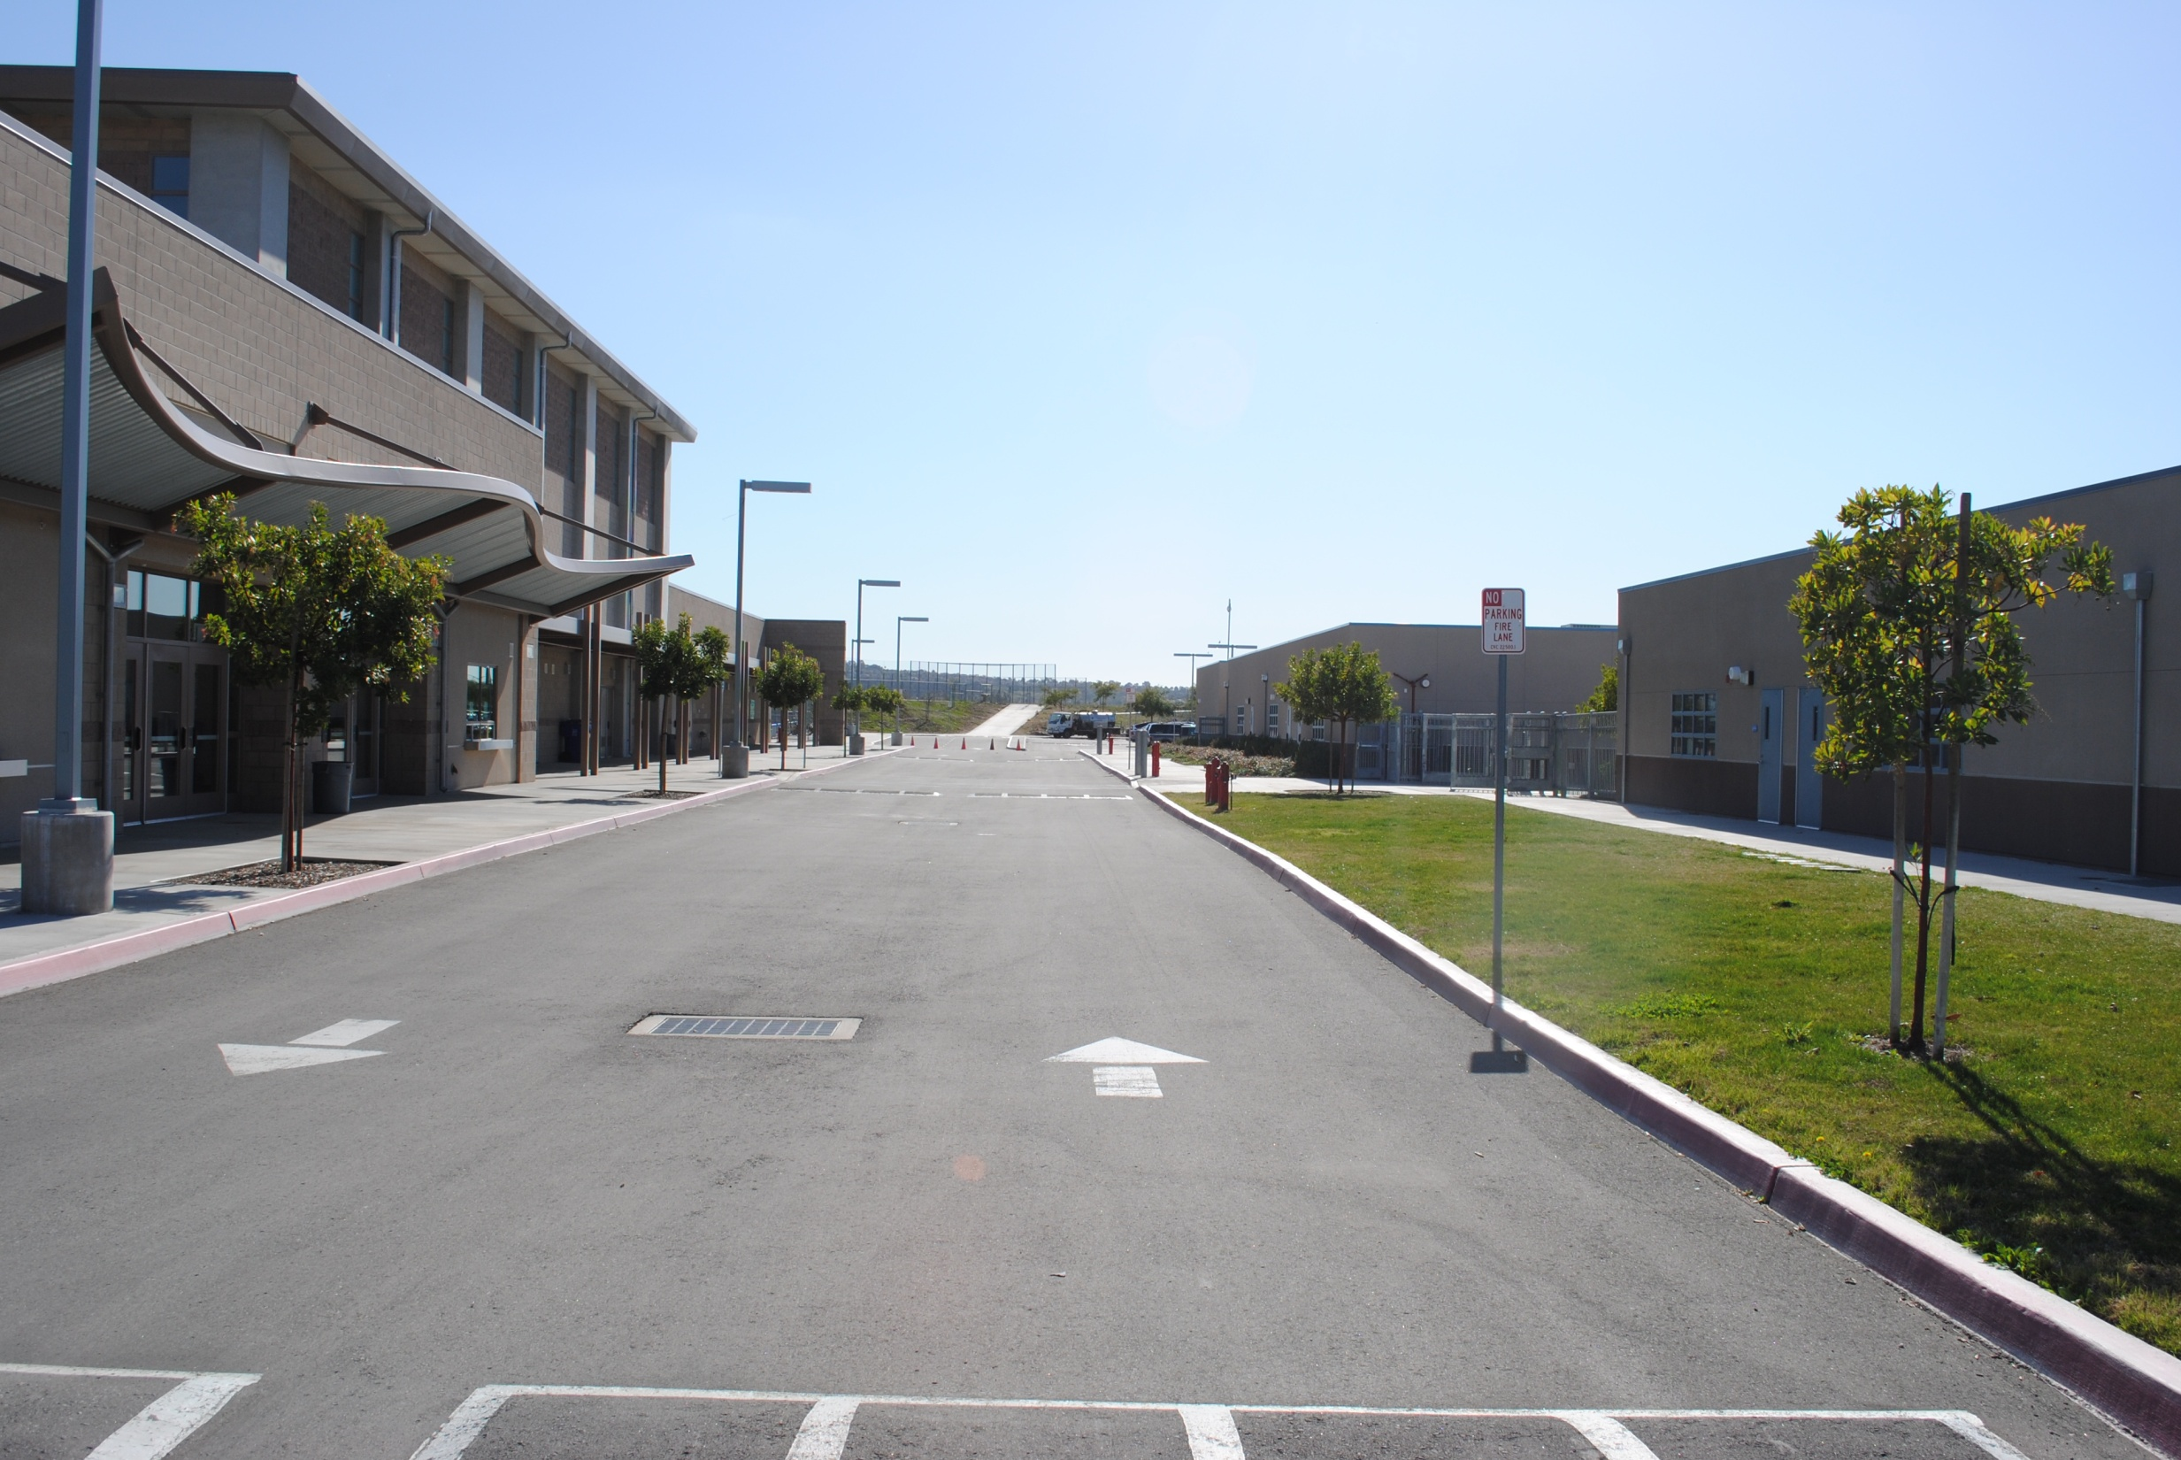
Curves

Slide 3
Portrait

Slide 4
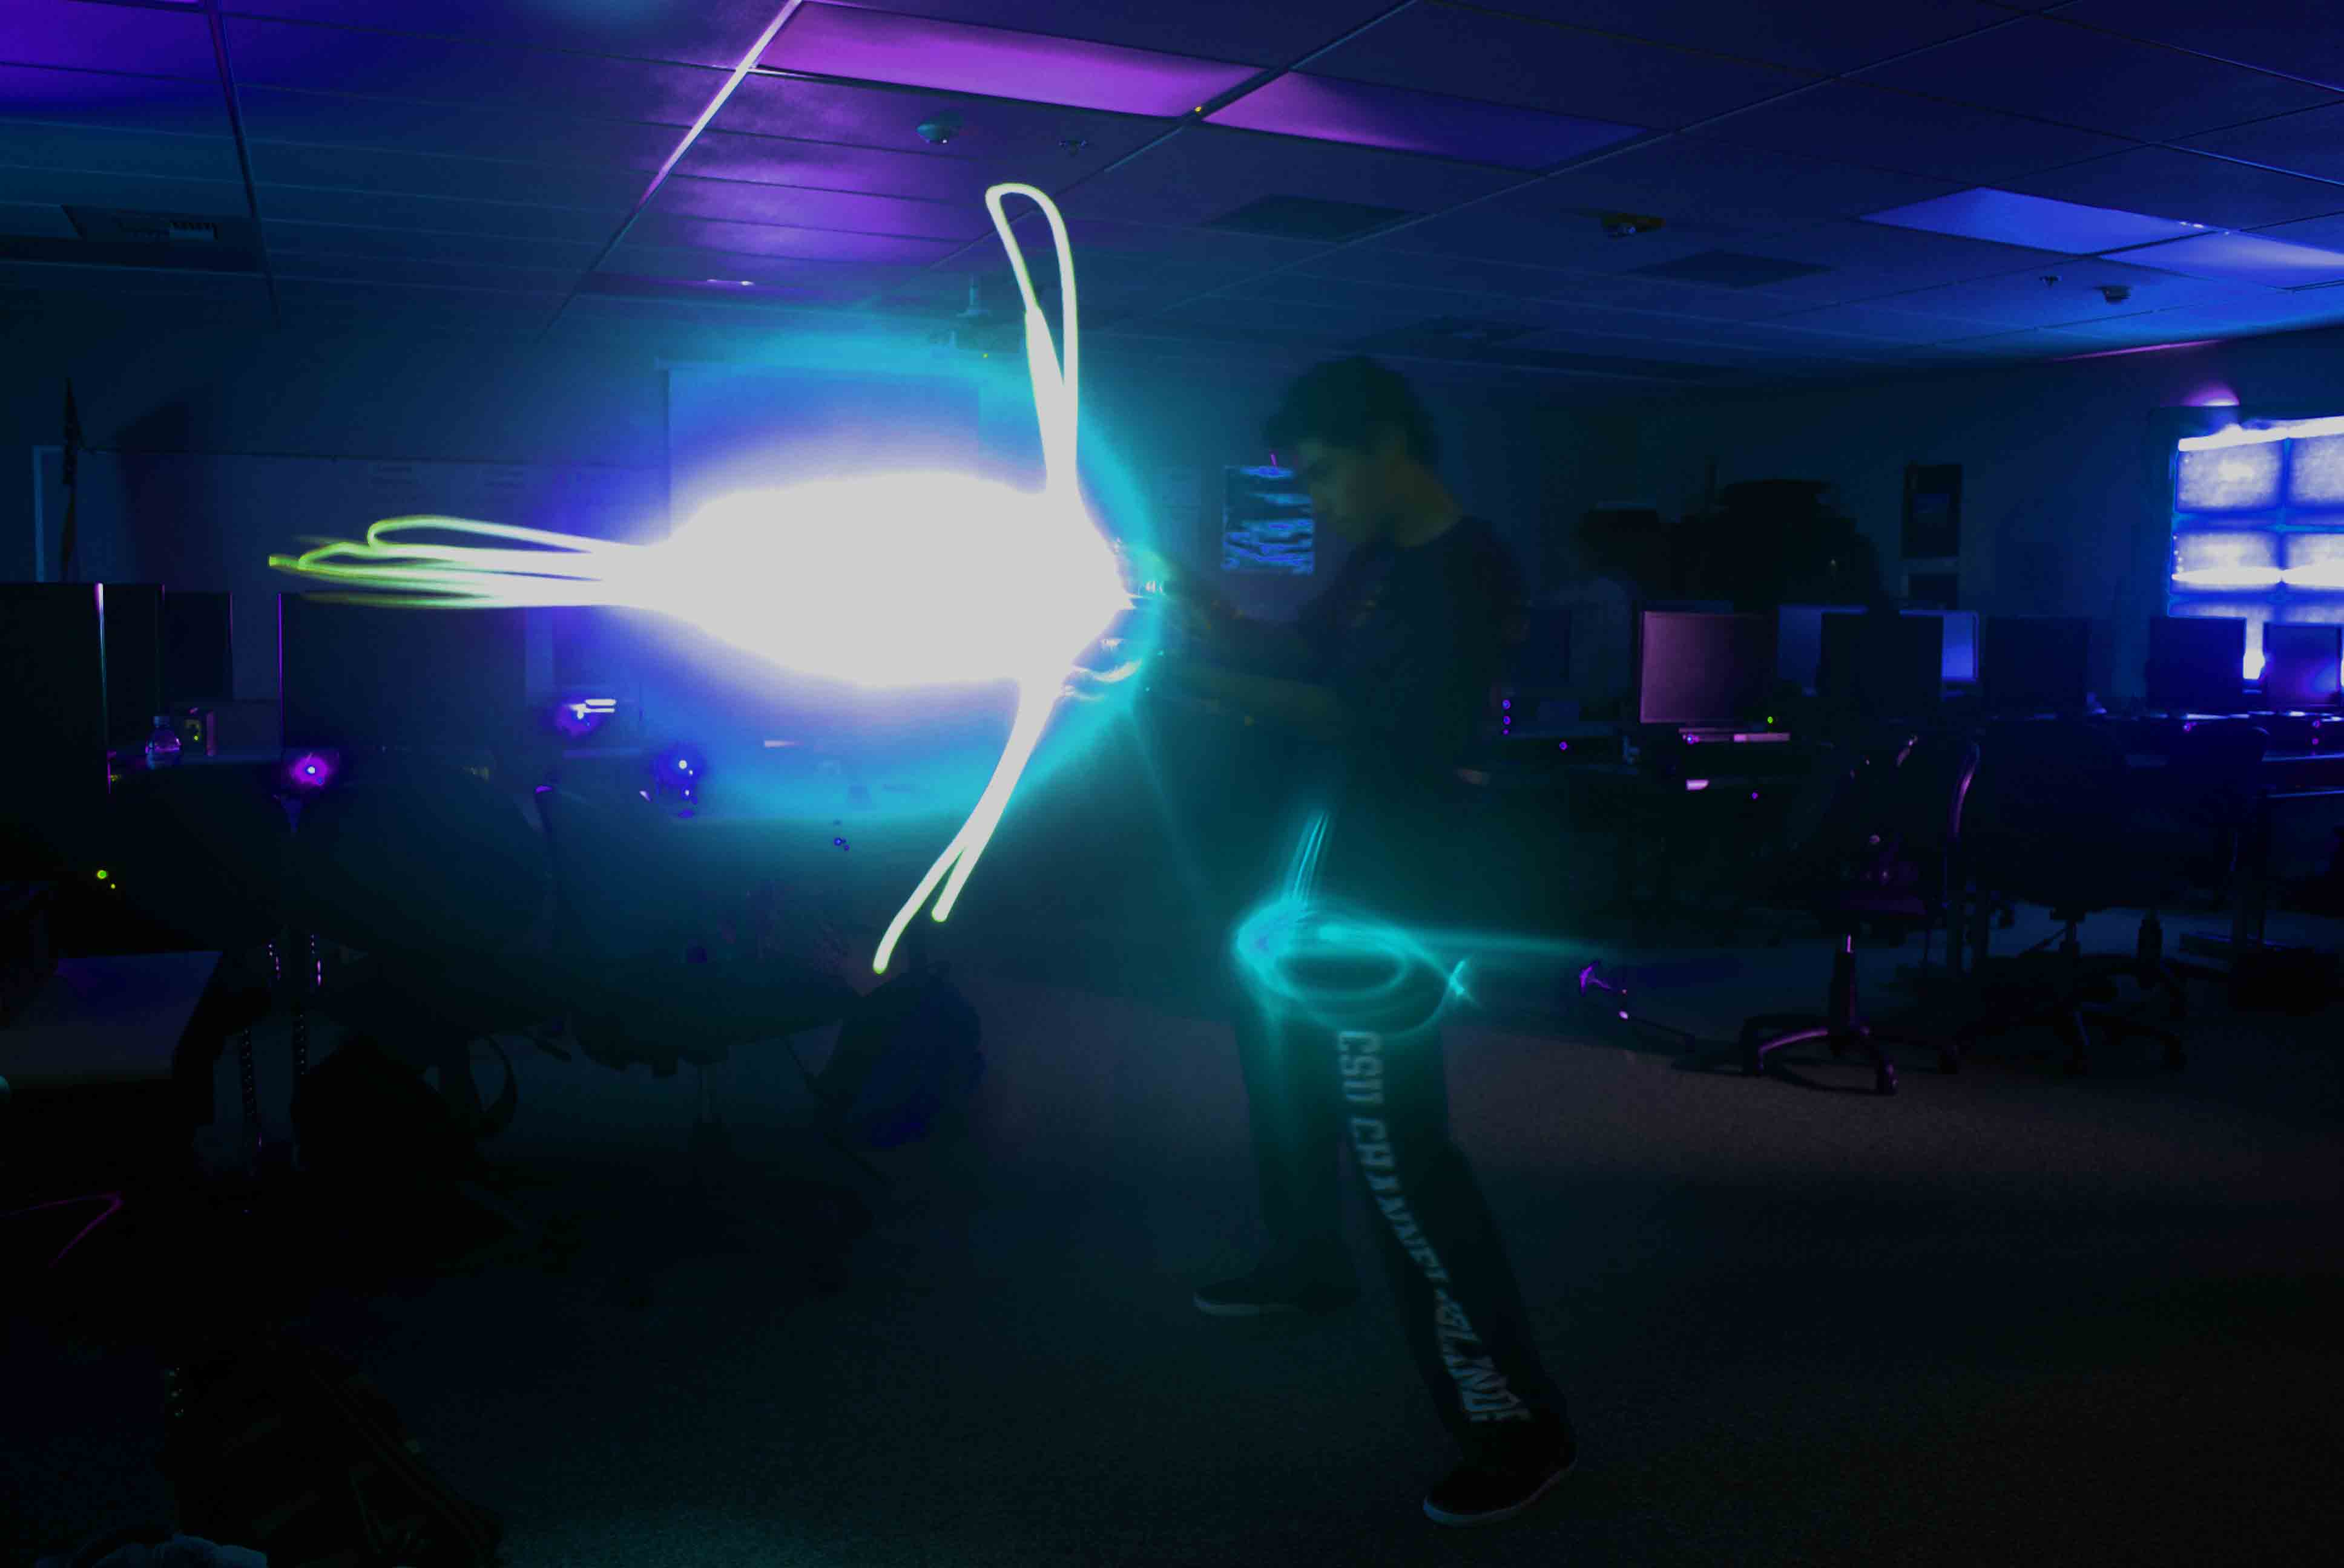
Light Photography

Slide 5
CD Cover

Slide 6
Panorama

Slide 7
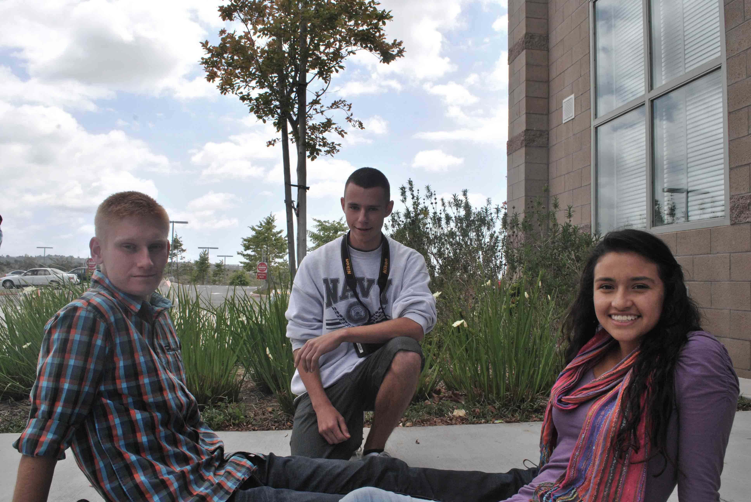
Group Photography

Slide 8
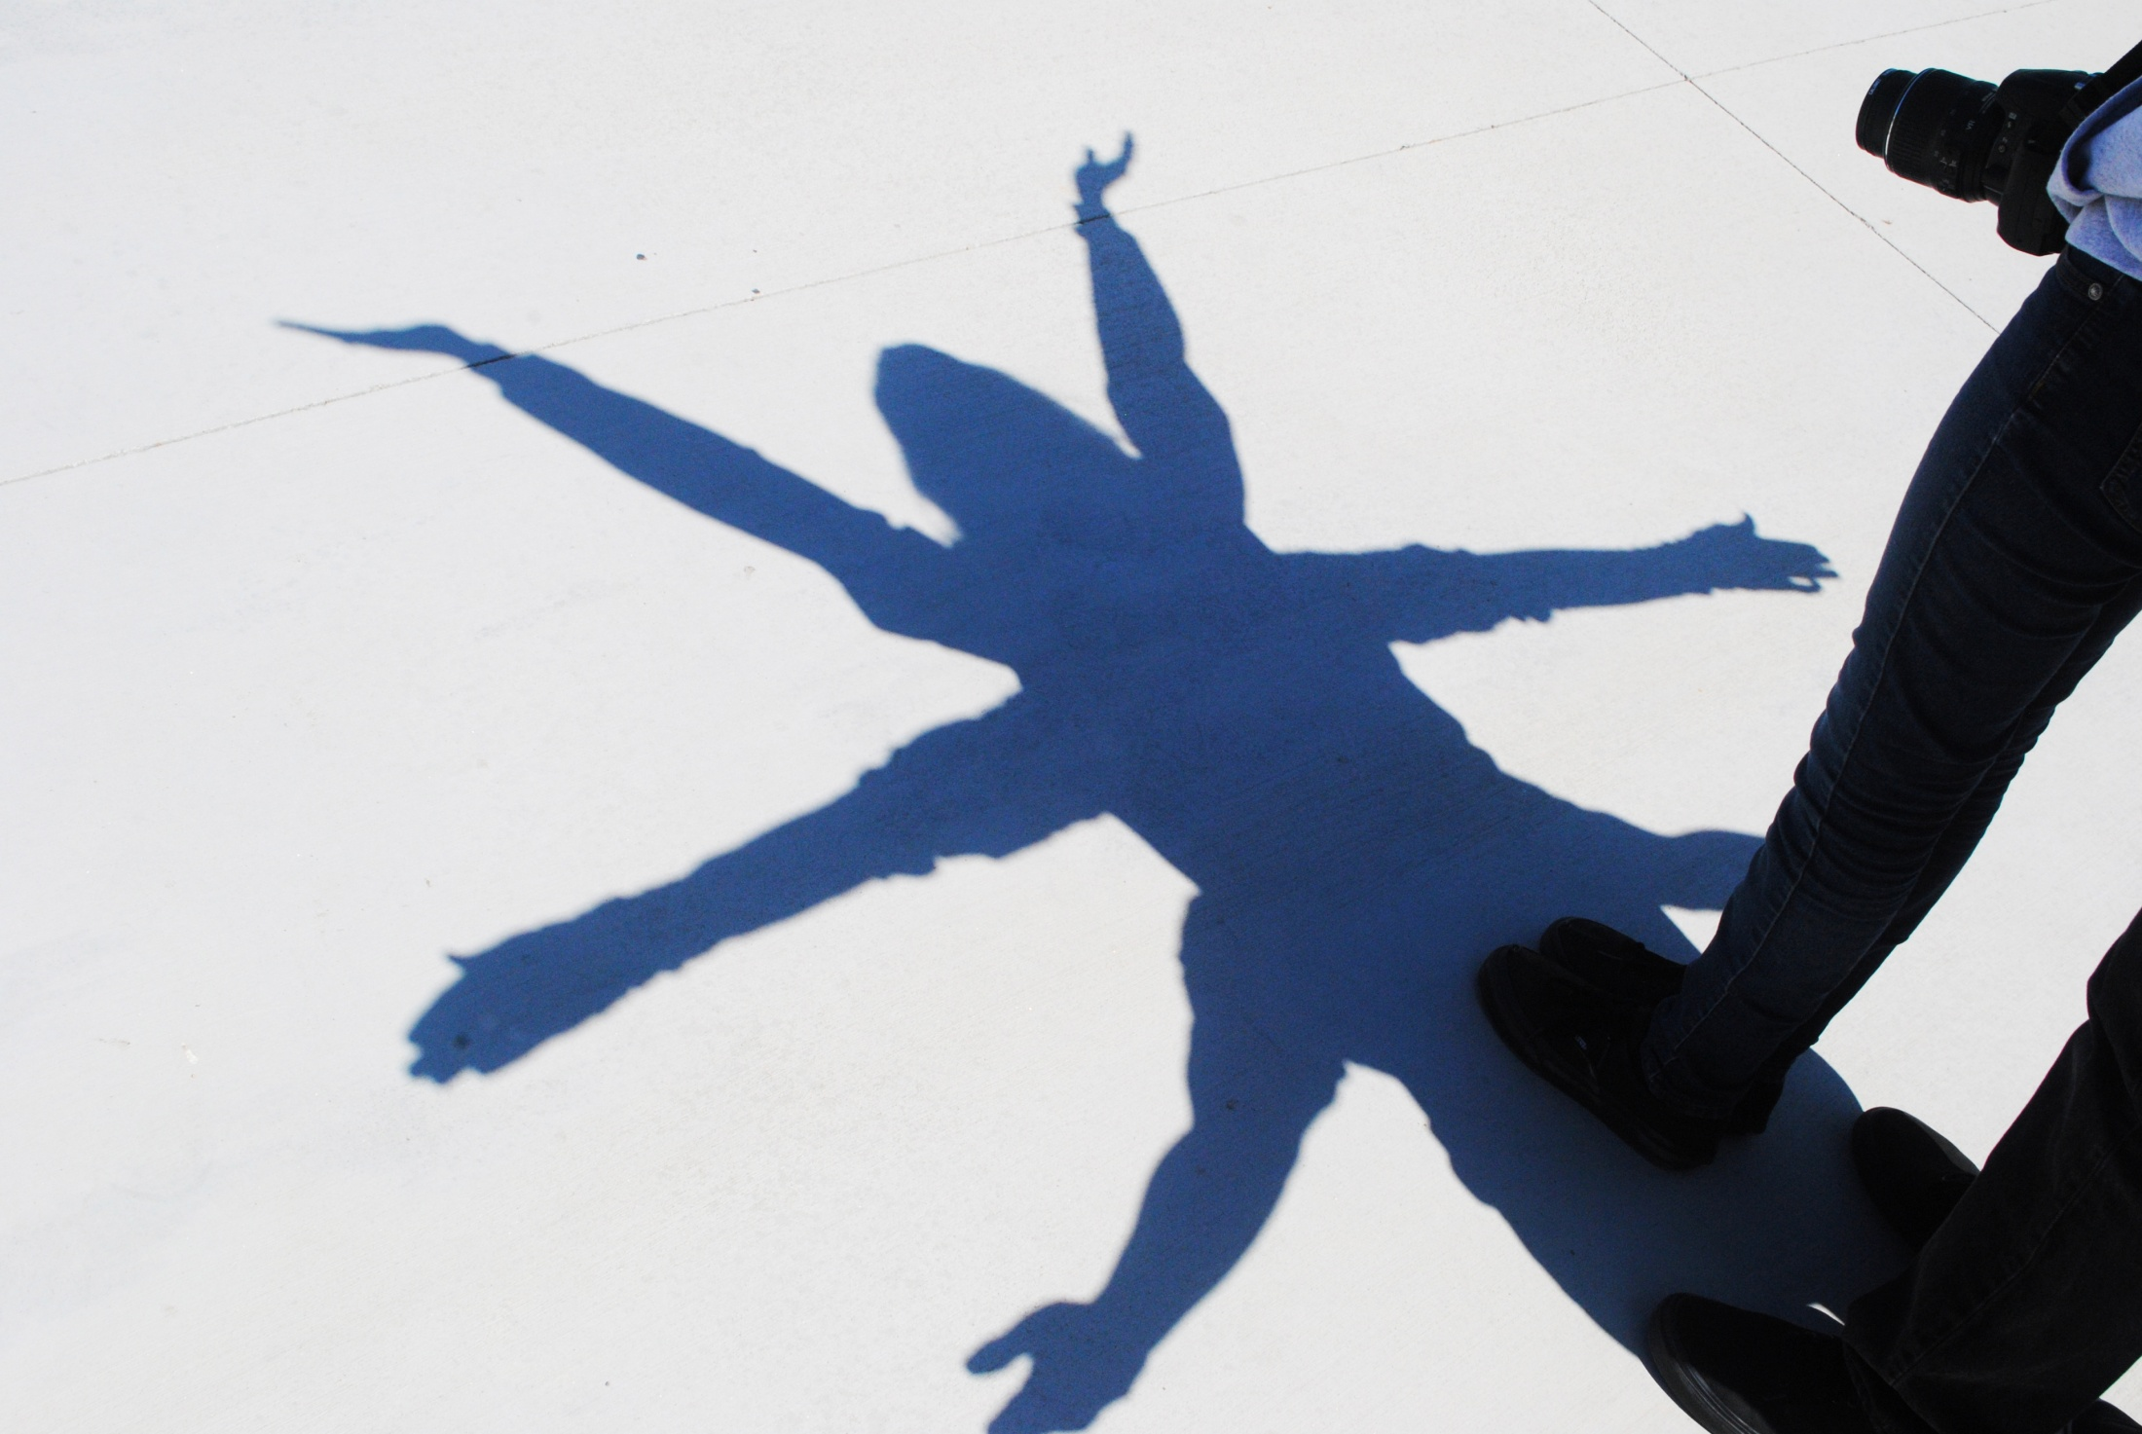
Shadow Photography

Slide 9
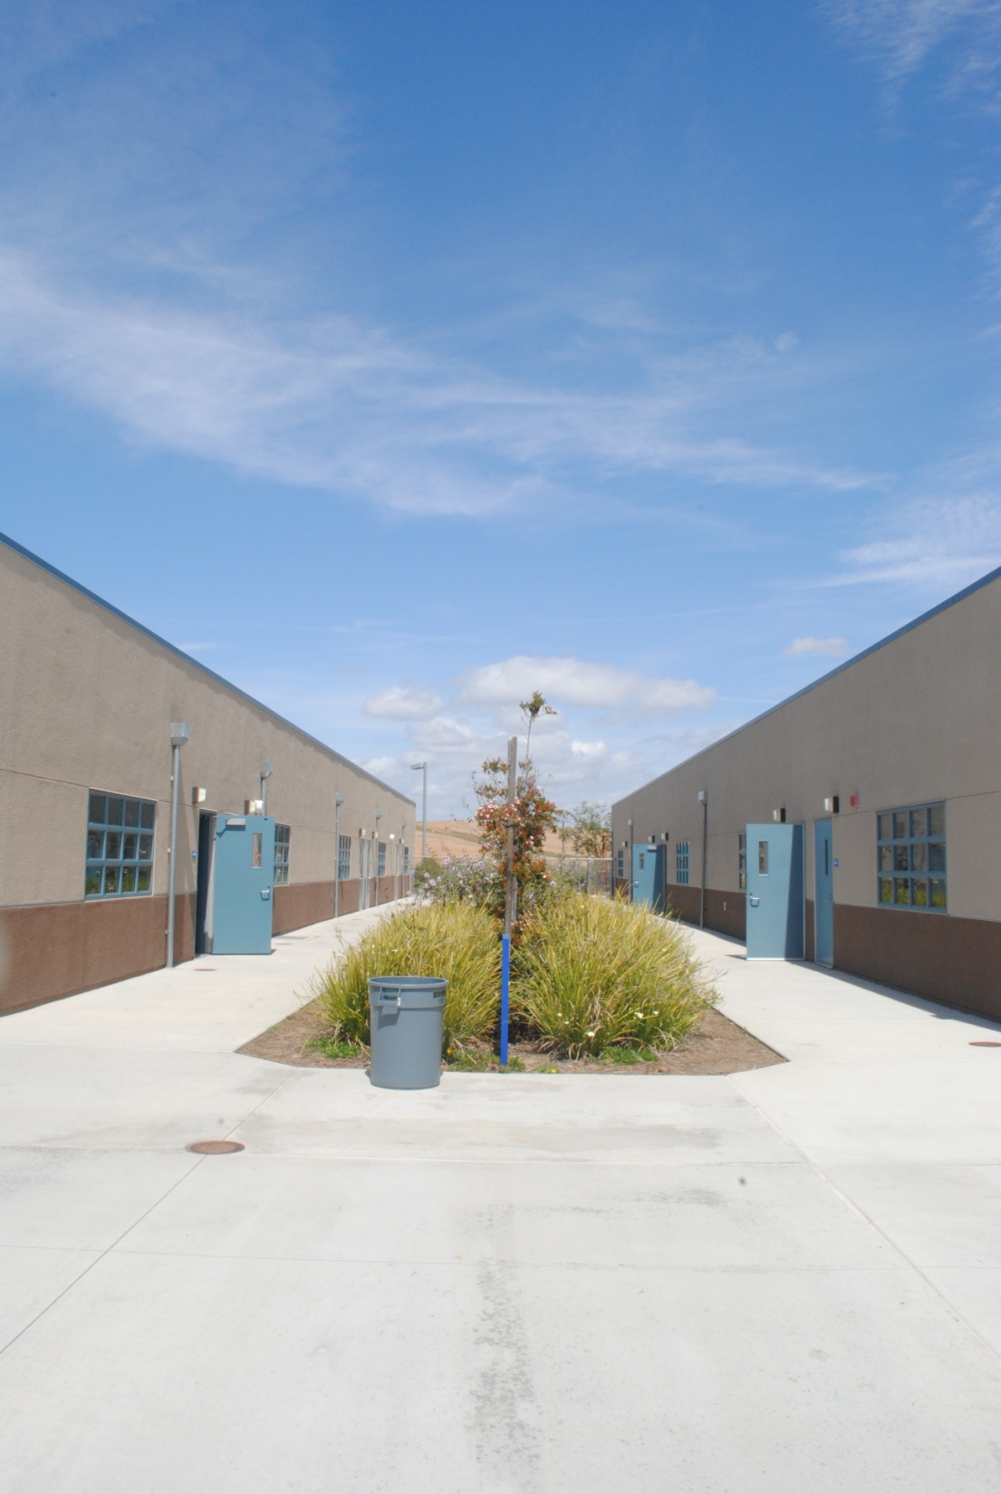
Symmetry

Slide 10
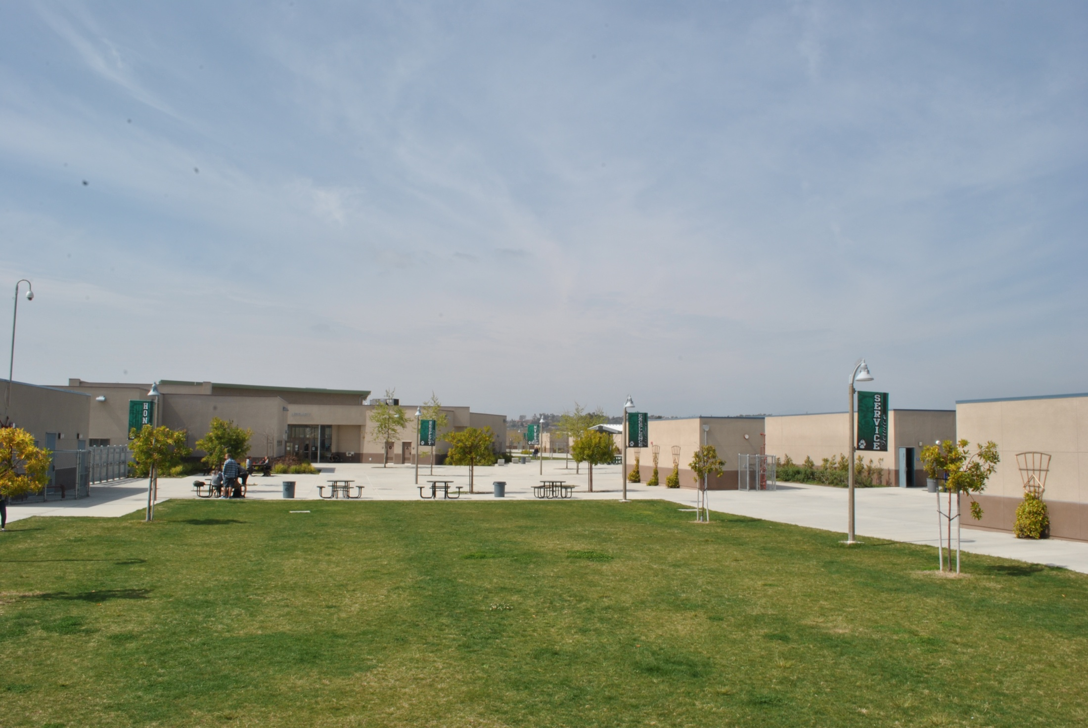
Landscape

